Slide 1

Door Security System
Name- Parth Purani
Internet Of Things

Slide 2
Index
Project Introduction
Project Components and Applications
Block Diagram
Flow Chart
Advantages
Disadvantages
Applications
Door System
Conclusion
References

Slide 3
Project Introduction
The implementation of IoT (Internet of Things) technologies has significantly enhanced security measures in various industries, enabling real-time monitoring and proactive threat detection, leading to reduced risks of cyberattacks and data breaches.
In an increasingly interconnected world, securing our homes and premises has become paramount. A door security system serves as a vital component of any comprehensive security setup, providing an efficient and reliable means to protect against unauthorized access and potential threats. By integrating modern technology and innovative features, these systems have evolved from traditional locks to intelligent solutions capable of enhancing safety, convenience, and peace of mind for both residential and commercial users.

Slide 4
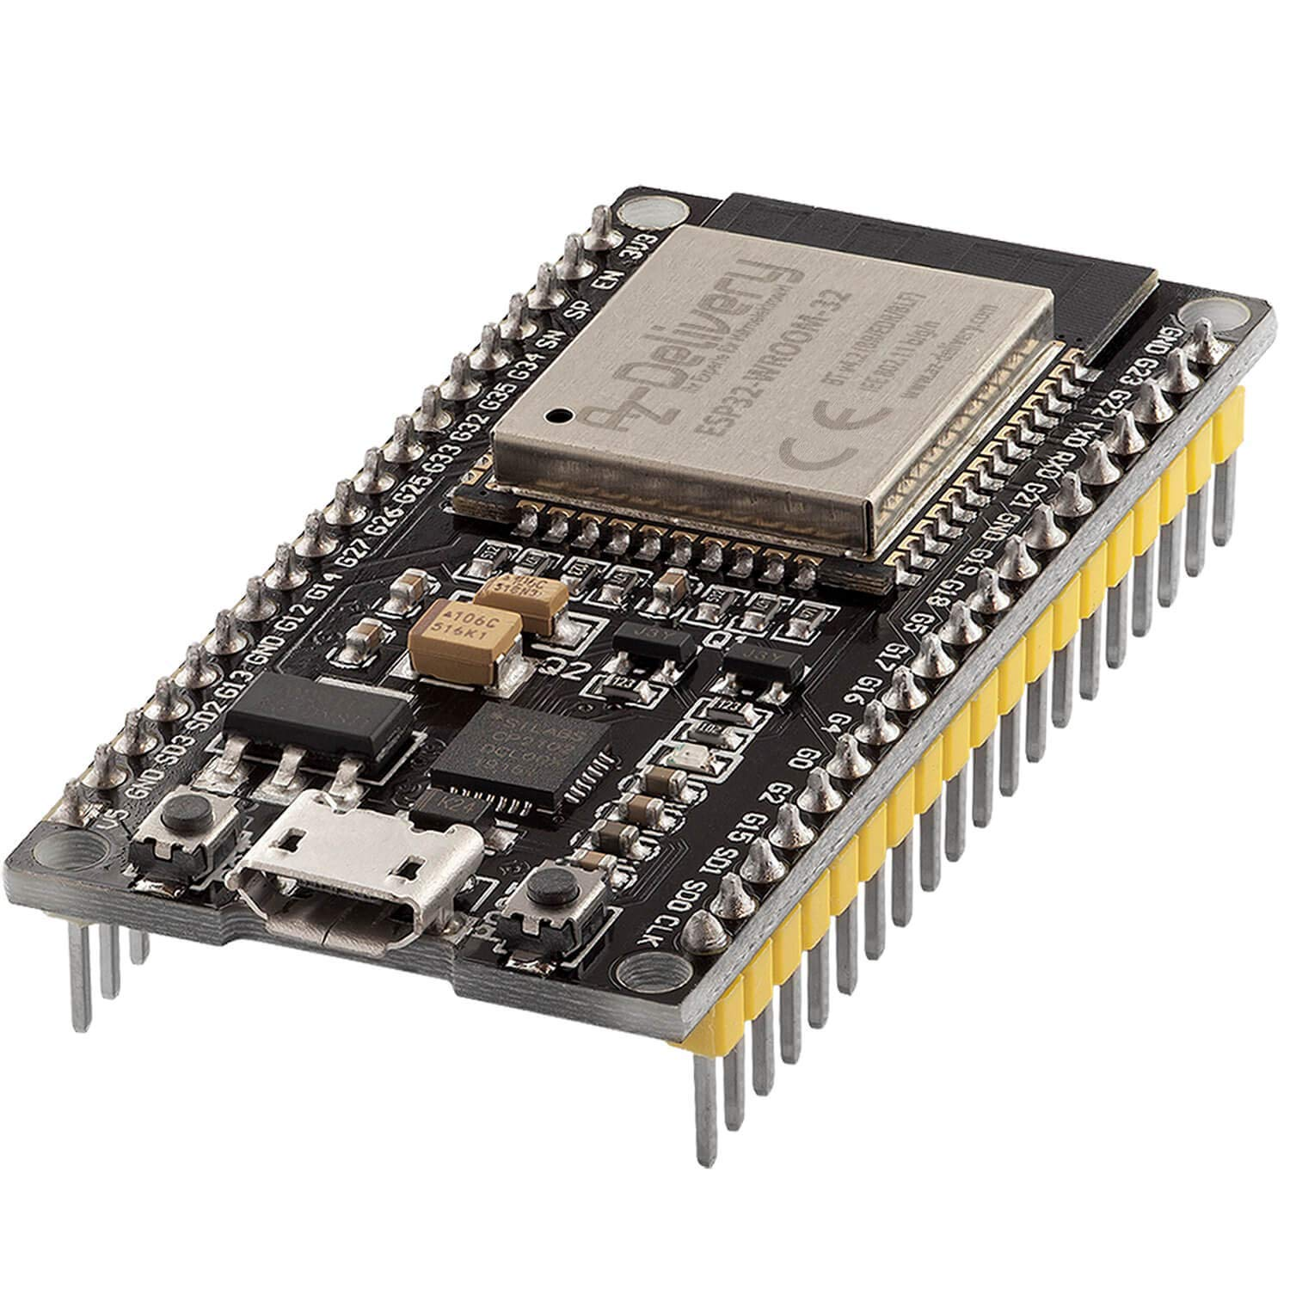
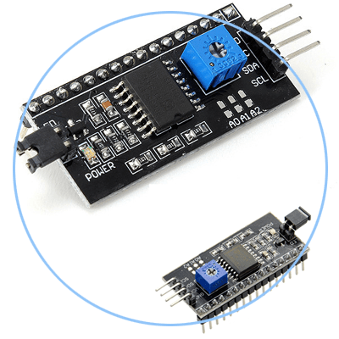
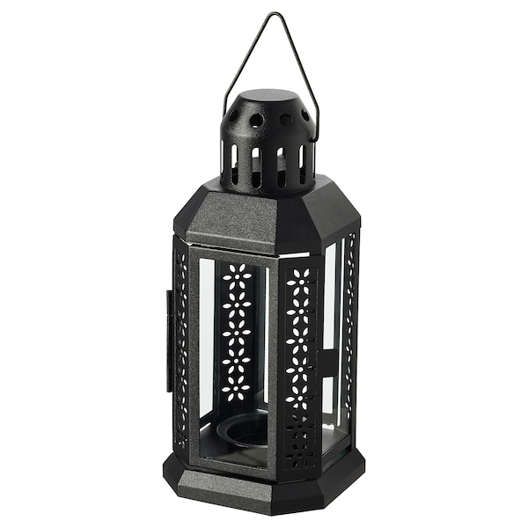
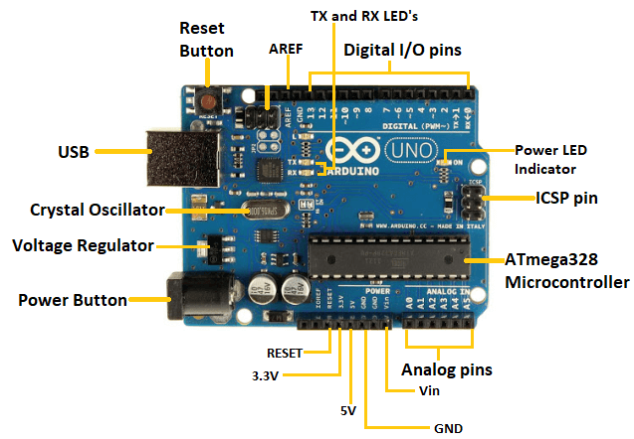
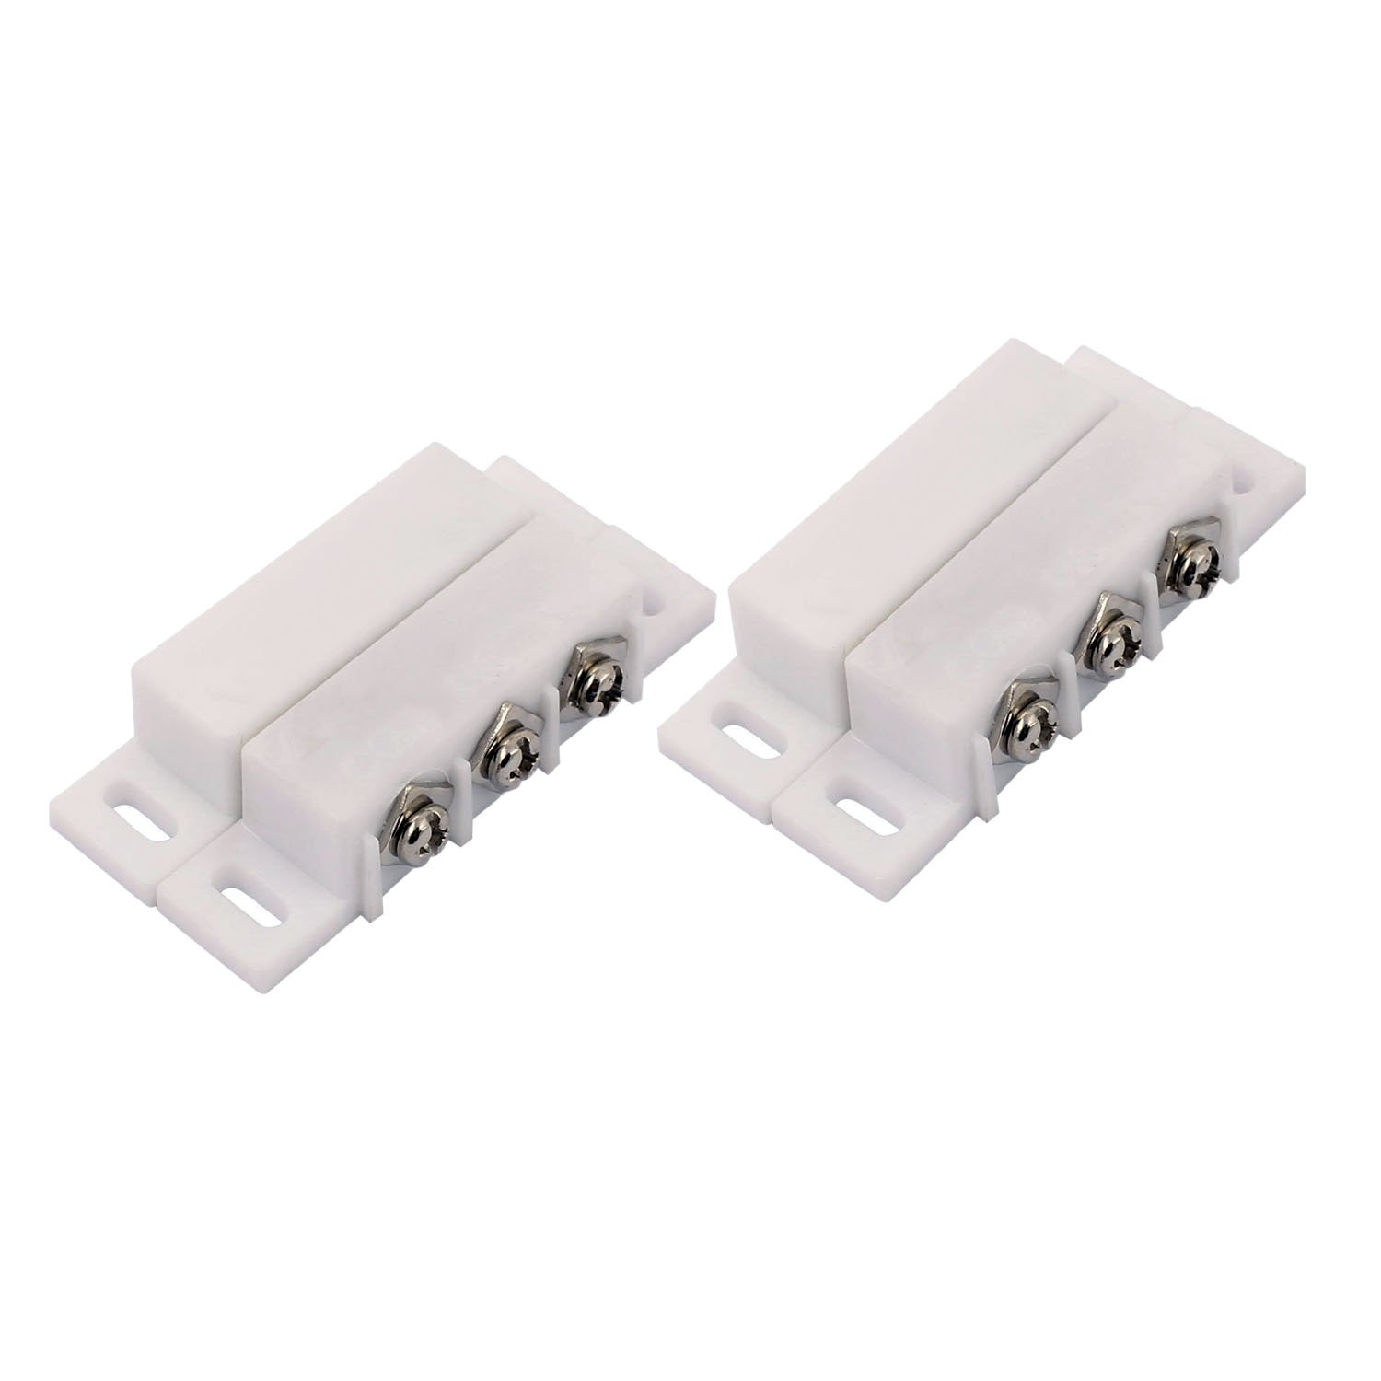
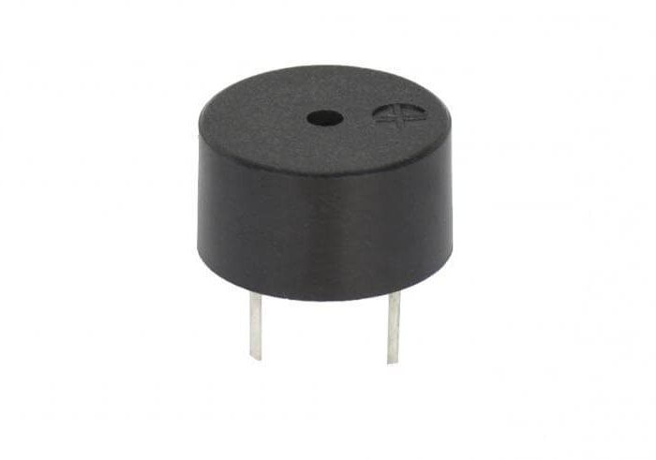
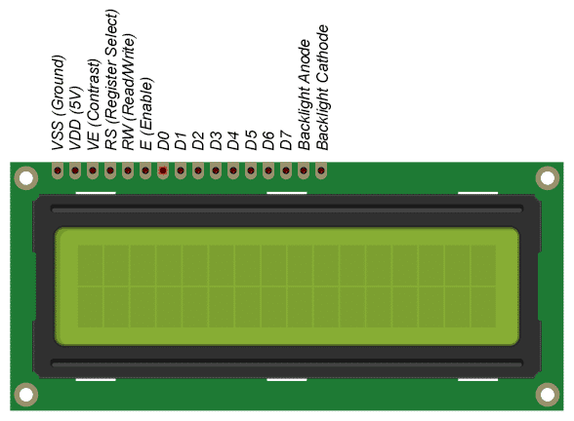
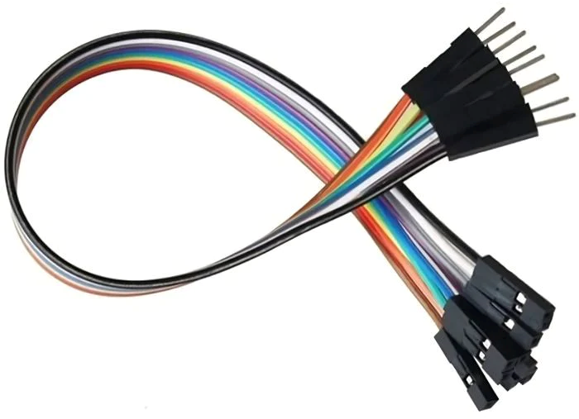
Project Components and Applications
4

Slide 5
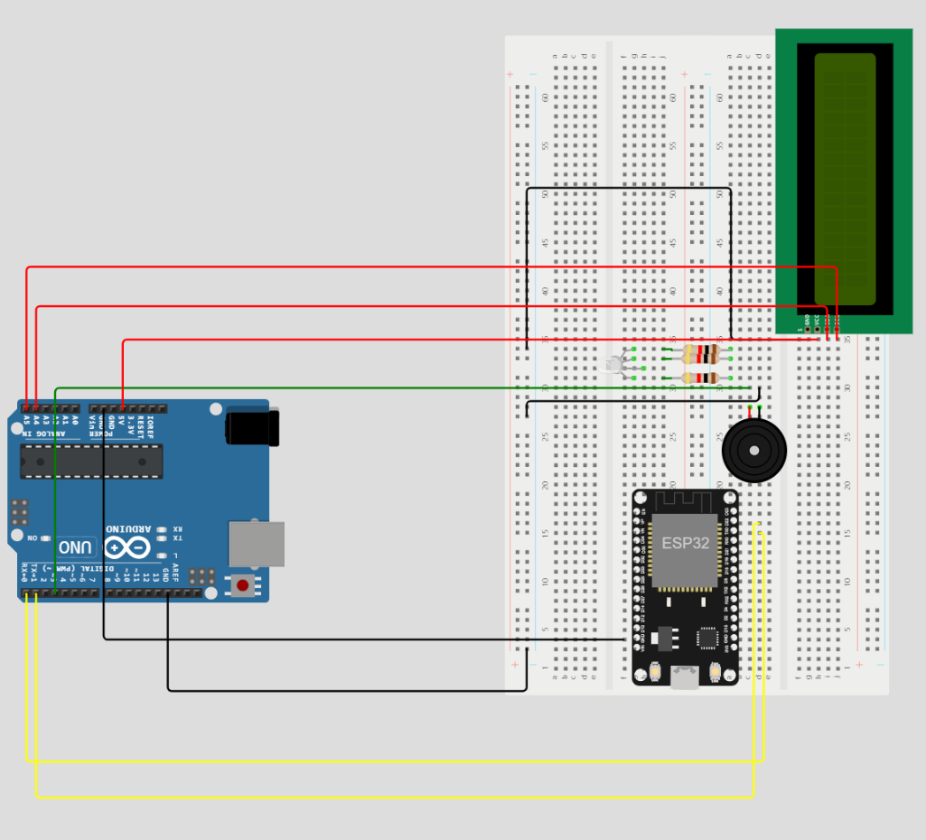
Block Diagram

Slide 6
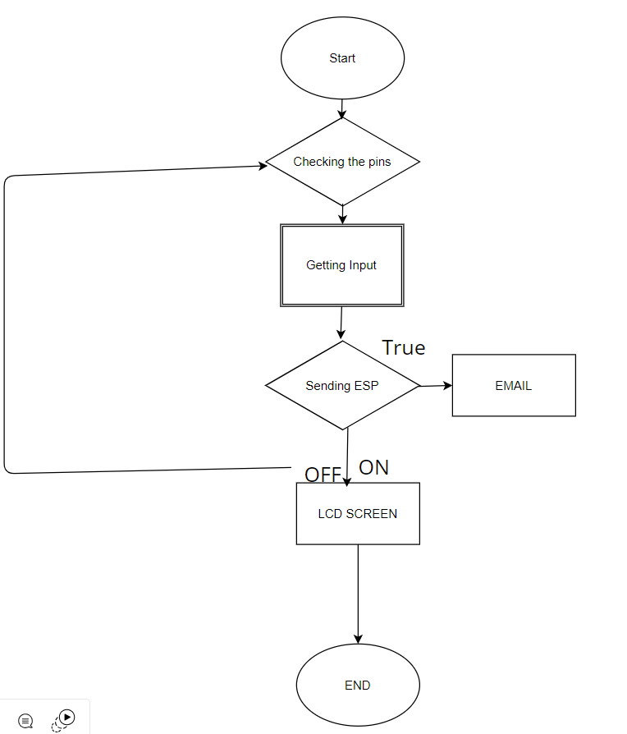
Flow Chart

Slide 7

Advantages
Cost Efficient
Regular Updates
Absolute Detection
Enhanced communication
Connectivity.
Secure

Slide 8

Disadvantages
Third Party Email
Power Inefficiency
Slaggy Function
Mandatory Input

Slide 9

Applications
Remote Access
Email Notifications
Integration with Smart Home Automation
Emergency Alerts
Buzzer
Onscreen Appearance

Slide 10

Door Security System
The internet-connected Door Security system, a true IoT device, provides real-time updates about door activity.
The integrated buzzer complements the screen, enhancing security, while users receive regular updates for added convenience.
Secure and efficient with alerts.

Slide 11

Conclusion
In summary, the internet-connected Door Security system exhibits several noteworthy advantages, including cost-efficiency, regular updates, precise detection capabilities, improved communication, and robust connectivity, all contributing to its overall security integrity. Nevertheless, it is essential to acknowledge certain drawbacks, such as reliance on third-party email services, potential power inefficiencies, occasional sluggish performance, and the necessity for mandatory user inputs.
Despite these limitations, the system demonstrates practical utility in various applications, encompassing remote access, prompt email notifications, seamless integration with smart home automation, expedient emergency alerts, and a user-friendly onscreen interface.
This amalgamation of features fosters a highly secure and efficient security solution, ensuring real-time alerts and heightened convenience for end-users.

Slide 12
References
ResearchGate. "Secure IoT Door Locks with Authentication." ResearchGate, 2019, https://www.researchgate.net/publication/337303188_Secure_IoT_Door_Locks_with_Authentication.
IEEE Xplore. "IoT-Based Smart Door Access Control System." IEEE Xplore Digital Library, 2018, https://ieeexplore.ieee.org/document/8544653.
Arduino Project Hub. "Arduino-Based IoT Door Lock System." Arduino Project Hub, https://create.arduino.cc/projecthub/mtanda09/arduino-based-iot-door-lock-system-2c4dfb.
IoT For All. "Smart Locks - Secure Your Home with IoT." IoT For All, https://www.iotforall.com/smart-locks-secure-your-home-with-iot/.
Arduino Project Hub. "ESP8266 IoT Door Lock." Arduino Project Hub, https://create.arduino.cc/projecthub/hgolkari/iot-door-lock-1ce8fc.
Circuit Digest. "NFC-Based Smart Door Lock." Circuit Digest, https://circuitdigest.com/microcontroller-projects/nfc-based-smart-door-lock-using-arduino.
Amazon Web Services (AWS). "Secure Door Lock System with AWS IoT." AWS IoT Blog, https://aws.amazon.com/blogs/iot/secure-door-lock-system-with-aws-iot/.
ResearchGate. "Zigbee-Based IoT Door Lock System." ResearchGate, 2021, https://www.researchgate.net/publication/344448632_Zigbee-Based_IOT_Door_Lock_System.

